Slide 1

Functional
Testing

Slide 2
Functional Testing
Decision Table Based Testing
Decision tables are an excellent tool to capture kinds of system requirements and to document internal system design.
They are used to record complex rules that a system must implement.
In addition, they can serve as a guide to creating test cases.
Decision tables are a vital tool in the tester’s personal toolbox.
Unfortunately, many analysts, designers, programmer, and testers are not familiar with this technique.
Useful when number of combination of actions are taken under varying set of conditions.

Slide 3
Functional Testing
Decision Table Based Testing
Parts of Decision table:
Conditions stub
Conditions entries
Actions stub
Actions entries
In decision table every column is associated with a rule and generates a test case.

Slide 4
Functional Testing
Condition Stub C₁ C₂ C₃ | Entry
 | True |  |  |  | False
 | True |  | False |  | True |  | False
 | True | False | True | False | True | False | True | False
Action a₁ Stub a₂ a₃ a₄ | X | X |  |  | X
 | X |  | X |  |  | X
 |  | X |  |  | X
 |  |  |  | X |  | X | X

Slide 5
Functional Testing
Limited Entry and Extended Entry Decision Tables
Decision tables which use only binary conditions are known as limited entry decision tables.
Decision tables which use multiple conditions where a condition may have many possibilities instead of only true and false are known as extended entry decision tables.
Do not care conditions
Represented by ‘-’ sign.
They do not have any effect on the output
Avoids redundancy

Slide 6
Functional Testing
Rule Count
Used with “do not care” entries in the decision table and has value 1 if “do not care” condition is not there but doubles for every do not care entry. Hence
each ‘do not care’ condition counts for two rules.
Rule Count=2 ^{no. of do not care conditions}
2. Only applicable for limited entry decision table.

Slide 7
Example : Decision Table Based Testing
Consider the triangle program. Identify the test cases using the decision table.
Notes:
Workshop on "How to find software faults before our customers find them" Copyright©2007

Slide 8
Test Case Design
C₁:x,y,z are sides of a triangle?
N
Y
C₂:x = y?
--
Y
N
C₃:x = z?
--
Y
N
Y
N
C₄:y = z?
--
Y
N
Y
N
Y
N
Y
N
a₁: Not a triangle
X
a₂: Scalene
X
a₃: Isosceles
X
X
X
a₄: Equilateral
X
a₅: Impossible
X
X
X
Decision table for triangle problem
Notes:
Workshop on "How to find software faults before our customers find them" Copyright©2007

Slide 9
Decision Table
Modified decision table
Conditions C₁ : x < y + z ? | F | T | T | T | T | T | T | T | T | T | T
C₂ : y < x + z ? | -- | F | T | T | T | T | T | T | T | T | T
C₃ : z < x + y ? | -- | -- | F | T | T | T | T | T | T | T | T
C₄ : x = y ? | -- | -- | -- | T | T | T | T | F | F | F | F
C₅ : x = z ? | -- | -- | -- | T | T | F | F | T | T | F | F
C₆ : y = z ? | -- | -- | -- | T | F | T | F | T | F | T | F
a₁ : Not a triangle | X | X | X
a₂ : Scalene |  |  |  |  |  |  |  |  |  |  | X
a₃ : Isosceles |  |  |  |  |  |  | X |  | X | X
a₄ : Equilateral |  |  |  | X
a₅ : Impossible |  |  |  |  | X | X |  | X
Notes:
Workshop on "How to find software faults before our customers find them" Copyright©2007

Slide 10
Example : Decision Table Based Testing
Solution
There are eleven functional test cases, three to fail triangle property, three impossible cases, one each to get equilateral, scalene triangle cases, and three to get on isosceles triangle. The test cases are as follows :
Test case | x | y | z | Expected Output
1
4
1
2
Not a triangle
2
1
4
2
Not a triangle
3
1
2
4
Not a triangle
4
5
5
5
Equilateral
5
?
?
?
Impossible
6
?
?
?
Impossible
7
2
2
3
Isosceles
8
?
?
?
Impossible
9
2
3
2
Isosceles
10
3
2
2
Isosceles
11
3
4
5
Scalene
Test cases of triangle problem using decision table
Notes:
Workshop on "How to find software faults before our customers find them" Copyright©2007

Slide 11
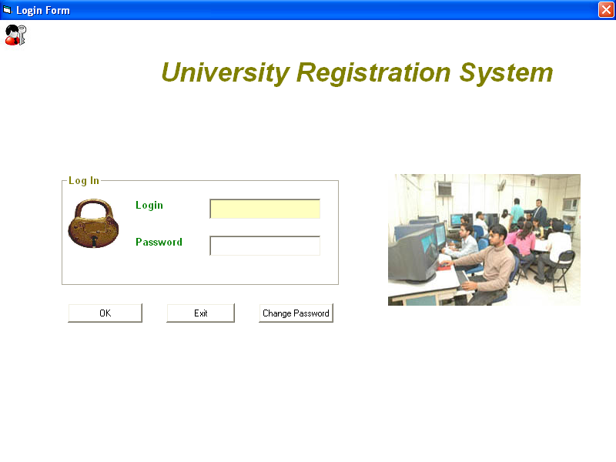
Equivalence Class Testing
Various fields available on this form:
Login Id: Alphanumeric of 11 characters in length and digits from 0 to 9 only are
allowed. Alphabets, special characters and blank spaces are not allowed.
Password: Alphanumeric in the range of 4 to 15 characters in length. Blank spaces
are not allowed. However, special characters are allowed.
Create Decision Table for login form
Notes:
Workshop on "How to find software faults before our customers find them" Copyright©2007

Slide 12
Decision Table Based Testing
Decision Table for login form
C₁ : User ID valid ? C₂ : Password valid ? | Entry
 | True |  | False
 | True | False | --
a₁ = Appropriate screen opens according to the role of user a₂ = Please enter correct ID and password | X
 |  | X | X
Notes:
Workshop on "How to find software faults before our customers find them" Copyright©2007

Slide 13
Functional Testing
Next Date Function
It illustrates the problem of dependencies in the input domain.
First Attempts
Identifying appropriate conditions and actions presents an opportunity for craftsmanship.

Slide 14
Functional Testing
Month
M₁ ={month : month has 30 days}
M₂={month : month has 31 days}
M₃={month : month is February}
Day
D₁={day : 1≤day ≤28}
D₂={day : day=29}
D₃={day : day=30}
D₄={day : day=31}
Year
Y₁={year : year is a leap year}
Y₂={year : year is a common year}

Slide 15
Functional Testing
Conditions
C₁ : month in M₁ ? | T
C₂ : month in M₂ ? | -- | T
C₃ : month in M₃ ? | -- | -- | T
C₄ : day in D₁ ?
C₅ : day in D₂ ?
C₆ : day in D₃ ?
C₇ : day in D₄ ?
C₈ : day in Y₁ ?
a₁ : Impossible
a₂ : Next Date

Slide 16
Functional Testing
The decision table will have 256 rules, many of which will be impossible.
If we want to show, why these rules are impossible, we should revise our actions.

Slide 17
Functional Testing
Second Attempt
M₁ ={month : month has 30 days}
M₂={month : month has 31 days}
M₃={month : month is February}
D₁={day : 1≤day≤28}
D₂={day : day=29}
D₃={day : day=30}
D₄={day : day=31}
Y₁={year : year = 2000}
Y₂={year : year is a leap year}
Y₃={year : year is a common year}
Any year divisible by 4 except century year is a leap year. For century year to be leap year, it should be divisible by 400.

Slide 18
Software Testing
The decision table is given below:
Sr.No. | 1 | 2 | 3 | 4 | 5 | 6 | 7 | 8 | 9 | 10 | 11 | 12 | 13 | 14 | 15 | 16
C₁: Months in
C₂: days in
C₃: year in
Rule Count
a₁: Impossible
a₂: Increment day
a₃: Reset day
a₄: Increment month
a₅: Reset month
a₆: Increment year
M₁
M₁
M₁
M₁
M₂
M₂
M₂
M₂
M₃
M₃
M₃
M₃
M₃
M₃
M₃
M₃
D₁
D₂
D₃
D₄
D₁
D₂
D₃
D₄
D₁
D₁
D₁
D₂
D₂
D₂
D₃
D₄
--
--
--
--
--
--
--
--
Y₁
Y₂
Y₃
Y₁
Y₂
Y₃
--
--
3
3
3
3
3
3
3
3
1
1
1
1
1
1
3
3
X
X
X
X
X
X
X
X
X
X
X
X
X
X
?
X
X
X
?
?
X
X
?
?

Slide 19
Functional Testing
The decision table has 36 rules and corresponding to the cartesian product of the equivalent classes.
Combining rules with do not care entries yield a decision table with 16 rules.
We still have problems with logically impossible rules, but this helps us to identify the expected outputs of a test case.
Third Attempt
This time, we want to be very specific about days and months, and we revert to the simpler leap year or non-leap year condition.

Slide 20
Functional Testing
M₁ ={month : month has 30 days}
M₂={month : month has 31 days except December}
M₃={month : month is December}
M₄={month : month is February}
D₁={day : 1≤day≤27}
D₂={day : day=28}
D₃={day : day=29}
D₄={day : day=30}
D₅={day : day=31}
Y₁={year : year is a leap year}
Y₂={year : year is a common year}

Slide 21
Functional Testing
Sr.No. | 1 | 2 | 3 | 4 | 5 | 6 | 7 | 8 | 9 | 10 | 11 | 12 | 13 | 14
C₁: Months in
C₂: days in
C₃: year in
a₁: Impossible
a₂: Increment day
a₃: Reset day
a₄: Increment month
a₅: Reset month
a₆: Increment year
M₁
M₁
M₁
M₁
M₁
M₂
M₂
M₂
M₂
M₂
M₃
M₃
M₃
M₃
Conditions
D₁
D₂
D₃
D₄
D₅
D₁
D₂
D₃
D₄
D₅
D₁
D₂
D₃
D₄
--
--
--
--
--
--
--
--
--
--
--
--
--
--
X
X
X
X
X
X
X
X
X
X
X
X
X
X
Actions
X
X

Slide 22
Functional Testing
Sr.No. | 15 | 16 | 17 | 18 | 19 | 20 | 21 | 22
C₁: Months in
C₂: days in
C₃: year in
a₁: Impossible
a₂: Increment day
a₃: Reset day
a₄: Increment month
a₅: Reset month
a₆: Increment year
M₃
M₄
M₄
M₄
M₄
M₄
M₄
M₄
Conditions
D₅
D₁
D₂
D₂
D₃
D₃
D₄
D₅
--
--
Y₁
Y₂
Y₁
Y₂
--
--
X
X
X
X
X
X
X
X
Actions
X
X
X
X
1-16= 2x16 = 32
21,22 = 2x2 = 4
17,18,19,20 = 1 each
Total = 40

Slide 23
Functional Testing
Test Cases
Case | Month | Day | Year | Expected output
1 | April | 15 | 2001 | April 16, 2001
2 | April | 28 | 2001 | April 29, 2001
3 | April | 29 | 2001 | April 30, 2001
4 | April | 30 | 2001 | May 1, 2001
5 | April | 31 | 2001 | Impossible
6 | Jan. | 15 | 2001 | Jan 16, 2001
7 | Jan. | 28 | 2001 | Jan 29, 2001
8 | Jan. | 29 | 2001 | Jan 30, 2001
9 | Jan. | 30 | 2001 | Jan 31, 2001
10 | Jan. | 31 | 2001 | Feb 1, 2001
11 | Dec. | 15 | 2001 | Dec 16, 2001
12 | Dec. | 28 | 2001 | Dec 29, 2001
13 | Dec. | 29 | 2001 | Dec 30, 2001
14 | Dec. | 30 | 2001 | Dec 31, 2001
15 | Dec. | 31 | 2001 | Jan 1, 2002

Slide 24
Functional Testing
Case | Month | Day | Year | Expected output
16 | Feb. | 15 | 2001 | Feb 16, 2001
17 | Feb. | 28 | 2004 | Feb 29, 2004
18 | Feb. | 28 | 2001 | March 1, 2001
19 | Feb. | 29 | 2004 | March 1, 2004
20 | Feb. | 29 | 2001 | Impossible
21 | Feb. | 30 | 2001 | Impossible
22 | Feb. | 31 | 2007 | Impossible

Slide 25
Functional Testing
Applicability and Limitations
Decision Table testing can be used whenever the system must implement complex business rules when these rules can be represented as a combination of conditions and when these conditions have discrete actions associated with them.

